Slide 1
International Travel Restart
Stakeholder Communications Toolkit
May 2021

Slide 2
Contents
Slide 3: Introduction
Slide 4: Working Together
Slides 5: Background
Slides 6-8: Key Messages
Slides 9-16: Carrier & border checks
Slides 17-24: Further Information to note
Slides 25-28: Assets

Slide 3
Introduction
This pack sets out the requirements for people travelling internationally from the UK.
It sets out core messages to consumers to help them understand and comply with the various health requirements to travel internationally.
This guidance refers to the requirements in England. In the UK, public health is a devolved matter. The requirements may differ in Scotland, Wales and Northern Ireland. Please check the relevant government websites for further information.

Slide 4
Working together to reopen international travel
This pack summarises the key guidance for re-opening international travel.
We've included quarantine, testing & PLF promotional assets for you to use throughout your customers’ journey, to ensure passengers understand the new rules and requirements to travel internationally. Full guidance is on gov.uk/coronavirus.
We've also included example vaccine and testing documentation to help your staff identify the correct documentation passengers should be carrying.
Your support is greatly appreciated. We are here to help by:
Providing a dedicated team to work with you and your colleagues to support the campaign.
Supplying you with the latest accurate and up-to-date messaging to share with your customers / members.
There may be opportunities to collaborate with you on media.

Slide 5
Background
The Government launched on 7 May 2021 the traffic light country system reopening international travel from England on 17 May. This allows the public to identify countries they can visit, whilst protecting the wider UK public health and the necessary requirements in place to achieve this.
The full list of countries, along with requirements, can be found online. The page will include a “Green Watchlist” to help outbound travellers identify countries most at risk of moving from green to amber. Please visit gov.uk/travel-abroad for guidance.
The Government’s priority remains to protect public health from COVID through these new travel measures and regulations. Given that the virus is still spreading in many parts of the world, people should not be travelling to amber and red countries.

Slide 6
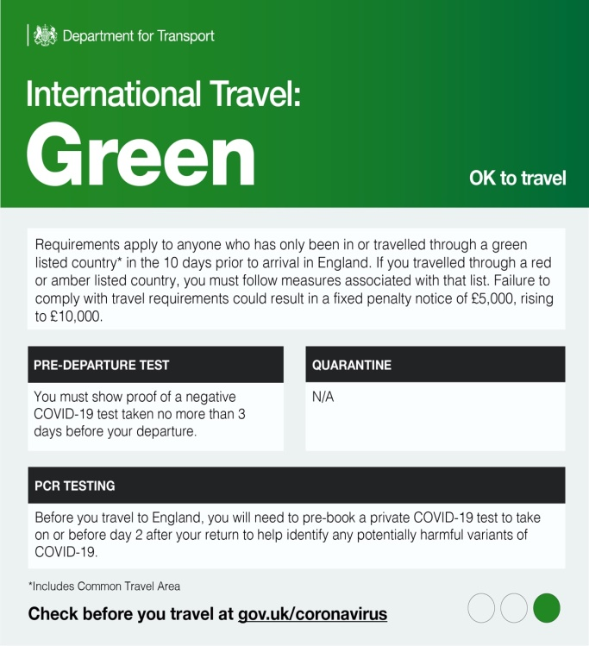
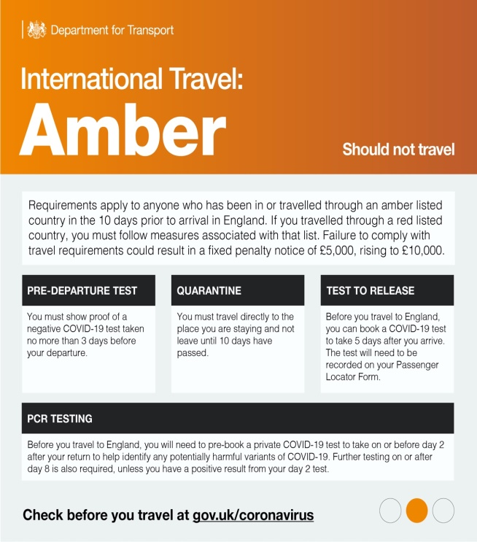
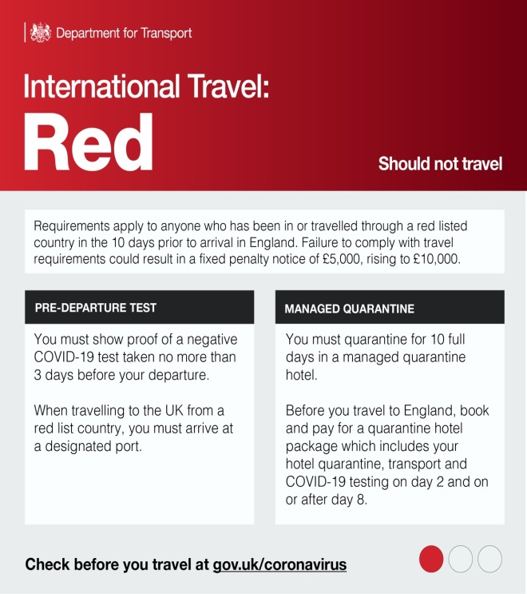
We are driving awareness across multiple channels, including broadcast, radio, press, digital and social media.

Slide 7
Key Messages
Core Messages for UK travellers
There are new travel restrictions and requirements in place to help stop the spread of coronavirus and its variants. Check gov.uk/travel-abroad page to help plan your journey. You must check the entry requirement for your chosen destination before you travel. You may be required to evidence your COVID-19 vaccination staus and/or show a negative PCR test result. You will need to take a pre-departure COVID-19 test within 72 hours of your return journey to England. Anyone testing positive prior to travel will not be permitted to travel back into England, will be required to follow local rules for isolation – you could incur additional costs during this period. Ensure you book COVID tests and complete relevant documentation (such as Passenger Locator Forms) for your destination and return to England. Those who have returned from red or amber list countries will be required to quarantine in a hotel (red) or at home (amber) for 10 days and take tests on or before day 2 and on or after day 8 of their quarantine. Those who have returned from green list countries will be required to take tests on or before day 2. Tests and quarantine must be booked prior to your return to the England.

Slide 8
Key Messages
Additional Messages
Ensure you book COVID tests and complete relevant documentation (such as Passenger Locator Forms) for your destination and return to England. Travellers may require their COVID-19 status certificate (either via the app or in paper format) when abroad to prove that they have conformed with the destination country’s requirements. There are new requirements when travelling in addition to COVID testing. Check: your passport is valid using gov.uk/check-passport and allow up to 10 weeks if you need to renew your passport. your travel insurance covers all needs including healthcare and you have a valid GHIC or in-date EHIC. you have the correct driving documentation for your destination. requirements if travelling with a pet. Sign-up for FCDO email alerts and check FCDO travel advice to get the latest updates for your destination. When returning to/arriving in England, be prepared for your arrival. Have all documentation ready, including your travel documents and your passenger locator form and be ready to remove face coverings where necessary. Passengers returning to England should check gov.uk/travel-abroad Non-UK residents should visit gov.uk/uk-border-control

Slide 9
Summary of Carrier Checks
Checks Mandated by UK Government
 | Departing England | Arriving in England
Passenger Locator Form (PLF) For all passengers regardless of country they are travelling from. |  | ✓
Passenger travelling to designated “Red” port For those passengers travelling from a “Red” list country. |  | ✓
Pre Departure Test (PDT) (Negative result) For all passengers regardless of country they are travelling from |  | ✓
Checks Mandated by Other Countries (Where Applicable)
 | Departing England | Arriving in England
Vaccine passport certification Where the destination country asks for evidence of certification. | Check
Additional country-specific requirements Passengers/carriers are encouraged to check local rules. | Check | Check
Where “Outbound” means travel from the UK to destination country, and where “Inbound” means return travel to the UK.

Slide 10
Covid vaccination status - Background
COVID-19 vaccination status is available to people who live in England from 17 May.
(https://www.gov.uk/guidance/demonstrating-your-covid-19-vaccination-status-when-travelling-abroad)
How to access a COVID-19 vaccination status :
English passengers can access their COVID-19 vaccination status through the free NHS App from 17 May. Passengers can access the app through mobile devices such as a smartphone or by tablet. Proof of their COVID-19 vaccination status will be shown within the NHS App. We recommend that they register with the app before booking international travel.
If they do not have access to a smartphone and know that the country they are travelling to requires COVID-19 vaccination status, they can call the NHS helpline on 119 (from 17 May) and ask for a letter to be posted to them. This must be at least 5 working days after they've completed their full course of the vaccine. We expect the letter to take 7 working days to reach them.

Slide 11
Covid status – what this means for your staff
Demonstrating vaccination status is an additional layer of Covid-19 security that may be required to be undertaken by check-in staff because of destination country legal requirements for inbound travellers.
Operators should acquire their own legal advice on destination country travel requirements for inbound passengers.
From 17 May check-in staff may be asked to check:
The name on a passengers’ Covid-19 vaccination status is the same as on their passport.
The date of birth on a passengers’ Covid-19 vaccination status is the same as on their passport.
A passengers’ Covid-19 vaccination status shows that they have had 2 doses of any approved vaccine.
The security watermark on the paper format.
If a passenger’s status information is not correct, check-in staff need to inform the passenger that they are not able to travel and then notify the relevant authorities if required.

Slide 12
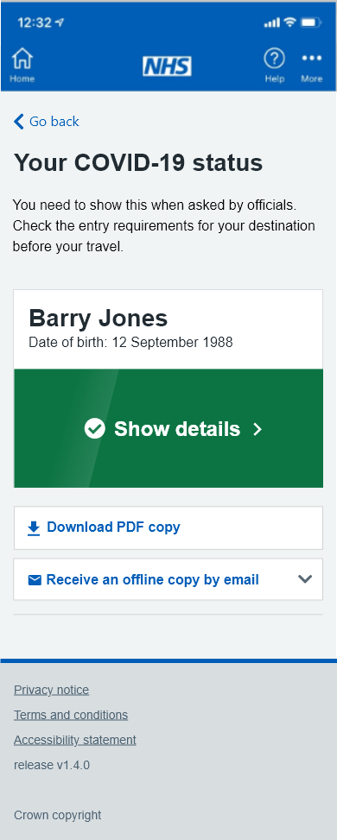
Covid status – Examples
EXAMPLE COVID-19 vaccination status app screen shots
Sensitive Information
Authorised status:
Green banner and
COVID-19 2 vaccines received
* Ask passengers to press the green banner on their app to then present their vaccine information

Slide 13
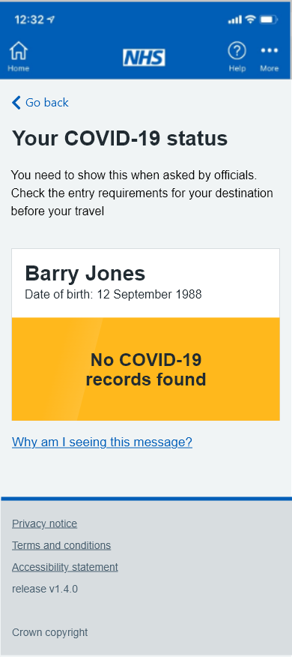
Covid status - Examples
EXAMPLE COVID-19 vaccination status app screen shots
Sensitive Information
Unauthorised status:
Amber banner
No COVID-19 vaccine records found

Slide 14
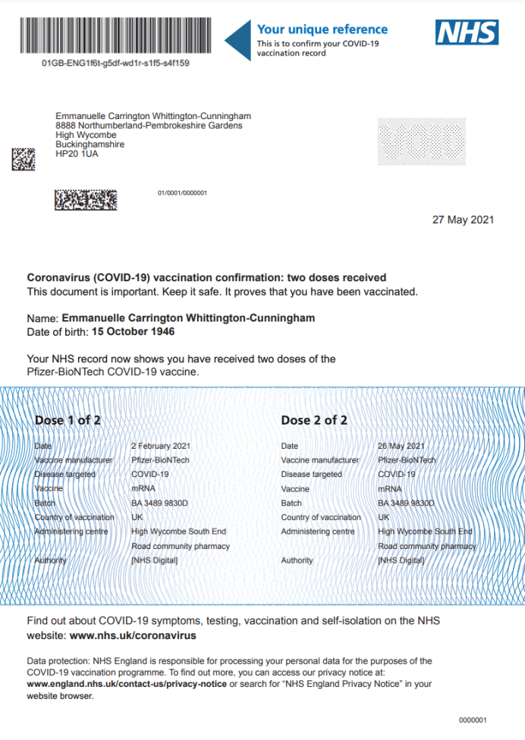
Covid status - Examples
EXAMPLE COVID-19 vaccination status paper format ( the letter branding may change to include all four nations)
Sensitive Information
Authorised status:
Full course of COVID-19 vaccine received
Physical security features:
Thermochromic ink (colour changes with heat)
Micro text under barcode
Guilloshe pattern (wavy lines)- also known as numismatic pattern
'COPY' void mark (shown as grey box on mark up)

Slide 15
Covid status – industry website information
Please display this information on all your passenger-facing channels
From 17 May, all English passengers will be able to show their COVID-19 vaccination status when travelling abroad to countries or territories that have stated this as an entry requirement.
Passengers need to have a full course of any approved vaccine (currently 2 doses) to be able to get their vaccination status.
For more information about how to get your COVID-19 vaccination status visit: Demonstrating your COVID-19 vaccination status when travelling abroad - GOV.UK (www.gov.uk)
There are not many countries that currently accept proof of vaccination. Please check the entry requirements for your destination country on the GOV.UK foreign travel advice pages

Slide 16
Border Checks
Reopening international travel while maintaining 100% health checks at the border means queues are inevitable.
It takes a trained border force officer an average of 5-10 minutes to check a passenger has a valid negative PCR test, has booked follow-up tests, has filled out the form to allow us to contact trace them correctly, and has a quarantine hotel booking where necessary. Where people do not have the required paperwork it can take considerably longer.
We understand that queues are frustrating but undertaking proper checks is the right thing to do to reduce the chances of a new variant of the virus entering the UK.

Slide 17
Further Information to Note

Slide 18
The Managed Quarantine Service
Quarantine reduces the risk of a new COVID-19 variant being transmitted from someone coming into England, protecting the UK’s vaccination programme.
Everyone who enters England having travelled in a red or amber list country must quarantine on return, and should arrange this in advance.
If you have travelled in or through a red list country in the last 10 days, you must quarantine for 10 full days in a managed quarantine hotel and take a coronavirus (COVID-19) test on or before day 2 and on or after day 8 of quarantining.
If you are travelling from an amber list country, you will need to quarantine for 10 days at home and take a coronavirus (COVID-19) test on or before day 2 and on or after day 8 of quarantining.
You will not be able to leave quarantine until you have received a negative result from your day 8 test and quarantined for 10 days.
If you do not follow quarantine rules, there may be consequences, including fixed penalty notices.
For information on how to book your test package or hotel quarantine go to www.gov.uk/coronavirus
The MQS can be booked here: https://quarantinehotelbookings.ctmportal.co.uk/.

Slide 19
Outbound Passenger Requirements: RED LIST
You should not travel to red list countries or territories.
Book a quarantine and testing package as required by your travel operator, airport and destination. The country you are travelling to may also require a test or quarantine.
Check the travel requirements of your destination country before you leave.
If you have to travel to a red list country, you will need to book a quarantine and testing package before your return to England.
You can book your quarantine in England here: https://quarantinehotelbookings.ctmportal.co.uk/.

Slide 20
Inbound Passenger Requirements: RED LIST
You should not travel to red list countries or territories.
Book a quarantine and testing package before travel to England if you have travelled in a red list (or ‘travel ban list’) country in the past ten days.
Take a pre-departure test and have proof of a negative result. You will also need to quarantine for 10 days in a managed quarantine hotel and take 2 PCR coronavirus (COVID-19) tests on or before day 2 and again on or after day 8.
Only those with residence rights in the UK will be allowed entry if you have travelled to a red list country in the past 10 days.
Information on how to book the quarantine package and the testing package and the list of banned (red list) countries can be found at www.gov.uk/coronavirus
Fill out a Passenger Locator Form (PLF) to record details of the quarantine and testing booking. Individuals are subject to a £10,000 fine and imprisonment for knowingly filling out the form incorrectly. All travellers must complete the PLF before travelling to England.
There are exemptions. For the full details go to www.gov.uk/coronavirus

Slide 21
Outbound Passenger Requirements: AMBER LIST
You should not travel to amber list countries or territories.
Book a quarantine and testing package before travel as required by your travel operator, airport and destination. The country you are travelling to may also require a test.
Check the travel requirements of your destination country.
If you have to travel to an Amber list country, you will need to book a testing package before you return to England.
Check Information on how to book the quarantine package and the testing package, it can be found at www.gov.uk/coronavirus.

Slide 22
Inbound Passenger Requirements: AMBER LIST
Book a testing package before travel to England if you have travelled in an amber list country [in the past ten days].
You will need to take a pre-departure test and have proof of a negative result. You will also need to quarantine for 10 days at home or the the place you’re staying and take 2 PCR coronavirus (COVID-19) tests on or before day 2 and again on or after day 8.
Information on how to book the testing package can be found at www.gov.uk/coronavirus
You may be able to end your quarantine early by booking a third coronavirus test, the earliest you can take a test is 5 days after you arrive in England. Find out more at www.gov.uk/coronavirus
Fill out a Passenger Locator Form (PLF) to record details of the quarantine and testing booking. Individuals are subject to a £10,000 fine and imprisonment for knowingly filling out the form incorrectly. All travellers must complete the PLF before travelling to England.
There are exemptions. For the full details go to www.gov.uk/coronavirus
Book a quarantine and testing package before travel as required by your travel operator, airport and destination. The country you are travelling to may also require a test.
Check the travel requirements of your destination country.
If you travel to a green list country you will need to book a test package before you return to England.
Check information on how to book the quarantine package and the testing package, it can be found at www.gov.uk/coronavirus

Slide 23
Outbound Passenger Requirements: GREEN LIST
Book a quarantine and testing package before travel as required by your travel operator, airport and destination. The country you are travelling to may also require a test.
Check the travel requirements of your destination country.
If you travel to a green list country you will need to book a test package before you return to England.
Check information on how to book the quarantine package and the testing package, it can be found at www.gov.uk/coronavirus

Slide 24
Inbound Passenger Requirements: GREEN LIST
Book a test package before travel to England if you have travelled in a green list country.
You will need to take a pre-departure test and have proof of a negative result.
You will also need to take a PCR coronavirus (COVID-19) test on or before day 2 of your return.
You do not need to quarantine unless you test positive. If you test positive, you will need to quarantine at home, or the place you are staying, for 10 days.
Fill out a Passenger Locator Form (PLF) to record details of your test booking. Individuals are subject to a £10,000 fine and imprisonment for knowingly filling out the form incorrectly. All travellers must complete the PLF before travelling to England.
There are exemptions. For the full details go to www.gov.uk/coronavirus

Slide 25
Assets available include:
1
2
3
Traffic Light System
Social statics
Social animation
International Travel
Checklist poster
Guidance poster
Border Force respect posters and digital designs
Hands, Face Space
Social post statics
Suggested Posts:
Audience: People travelling abroad
Suggested post: Planning to travel abroad? You will likely need to quarantine on return The rules have changed. Visit gov.uk/coronavirus before you travel
Audience: people travelling to England
Suggested post: Travelling to the UK? There are new quarantine and testing rules. Visit gov.uk/coronavirus before you travel to find out more
All materials will be available on the DfT extranet and on: https://coronavirusresources.phe.gov.uk/

Slide 26
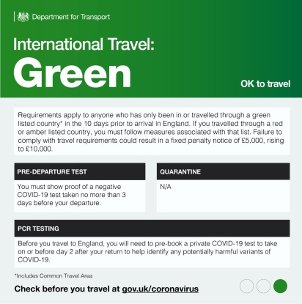
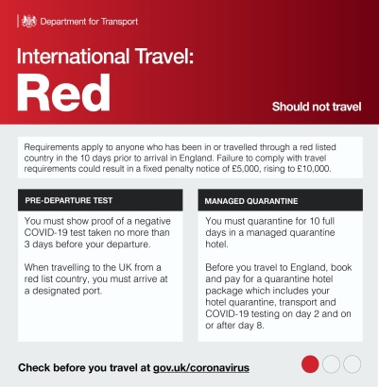
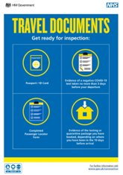
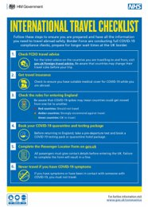
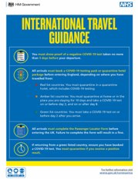
Assets & Amplification
There is a suite of assets available to help partners amplify the messages- all available on our partner extranet and the PHE Campaign Resource.
Display the print assets in locations that will reach travel staff and passengers.
Communicate the campaign messages via your digital channels, such as web banners on your site, using the email signature if you deal with haulage managers.
If you have social channels used predominantly by passengers or the travel industry, use the campaign social assets.

Slide 27
Border Force ‘respect’ posters & digital
These posters and digital designs can be displayed in ports, especially when long queues are expected. They encourage the public to respect Border Force staff.
Available for download here.

Slide 28
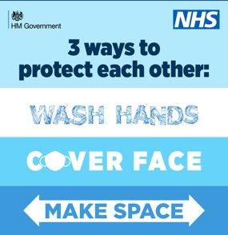
Hands, Face, Space
These assets encourage the public to regularly wash their hands, wear a face covering unless medically exempt and maintain space through social distancing. These can be used throughout ports to encourage adherence.
Available here on the Public Health England Campaign Resource Centre.

Slide 29
Thank You

